Slide 1

HEALTH
MANAGEMENT ORGANISATION (HMO)

Slide 2
Insights on Dataset
Analyzing Data
The primary objective of the project is to provide insights based on findings in the dataset.
Analyzing datasets in order to establish the relationship between medical costs and variables in the dataset
PROJECT
GOALS
Determining Variables
Recommendation
Understanding the variables that affect the health cost:
1) Age 2) Hypertension
3) Smoker 4) Exercise
5) BMI 6) Location
Based on the analysis, provide recommendations on reduction in health costs of individuals.

Slide 3
PROJECT PHASES
Recommendation
Data Modeling &Visualization
Key Variables
Data Cleansing
Data Exploration

Slide 4
DETERMINANTS OF HEALTH CARE COSTS
AGE
LOCATION
HYPERTENSION
BMI
SMOKER
EXERCISE

Slide 5
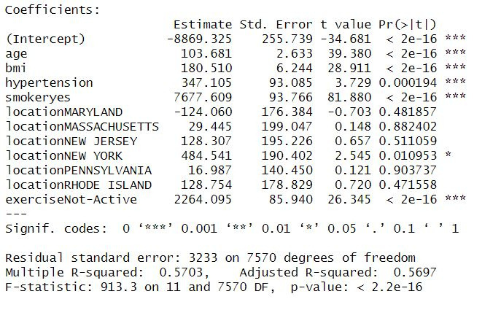
MODELS USED
LINEAR MODEL

Slide 6
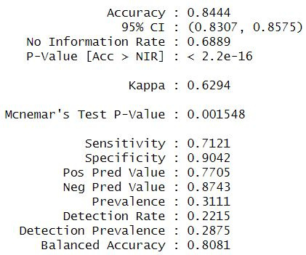
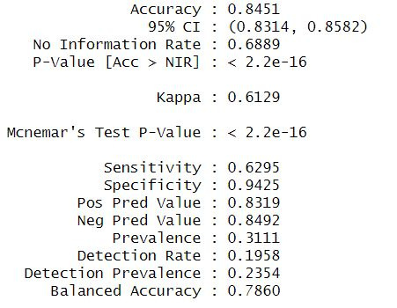
MODELS USED
TREEBAG MODEL
SVM MODEL

Slide 7
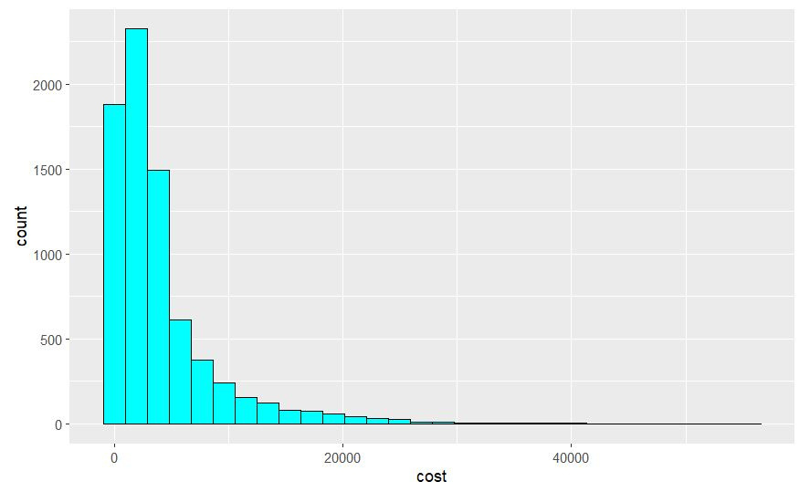
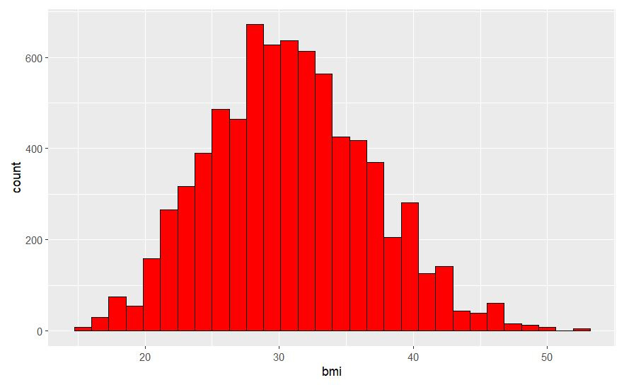
COST AND BMI HISTOGRAMS

Slide 8
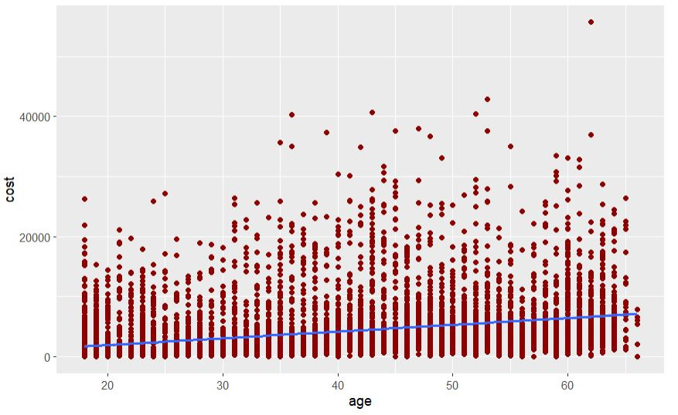
CORRELATION OF COST AND AGE
Age and healthcare costs have a positive correlation, i.e.,
as age increases healthcare expenses also increase

Slide 9
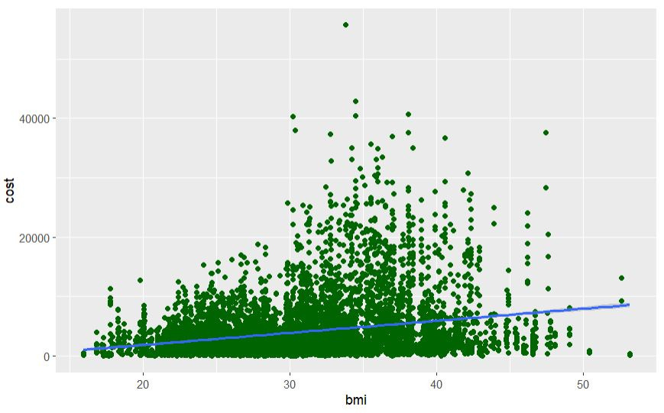
CORRELATION OF COST AND BMI
BMI and healthcare cost have a
positive correlation, i.e.,
as BMI increases healthcare expenses also increase

Slide 10
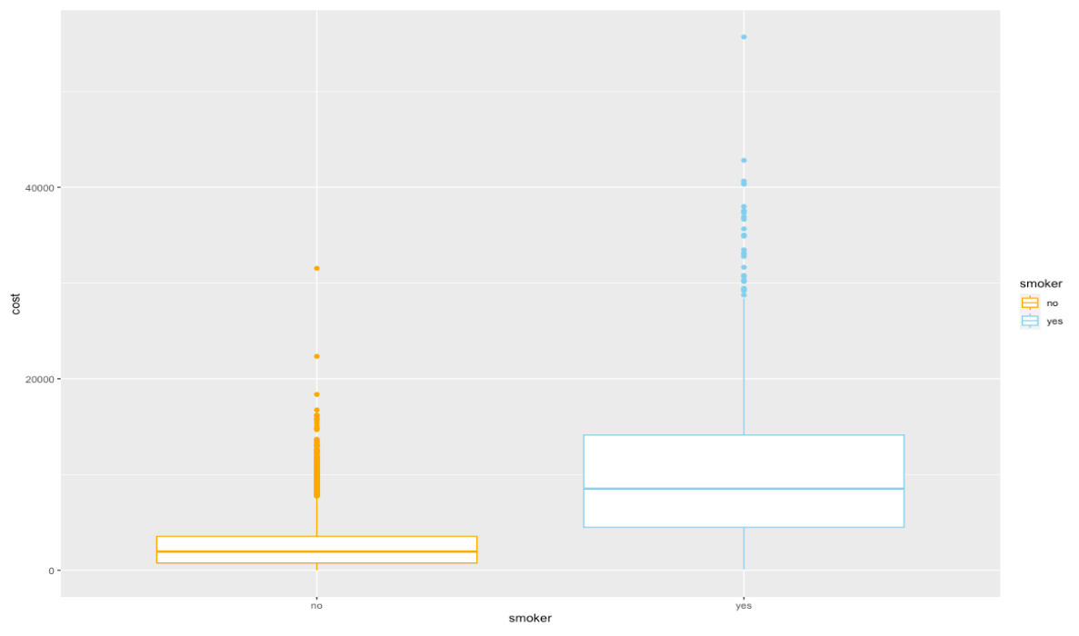
CORRELATION OF COST AND
SMOKERS AND NON-SMOKERS
As we can see, the healthcare expenses of a smoker are very high compared to that of a non-smoker.

Slide 11
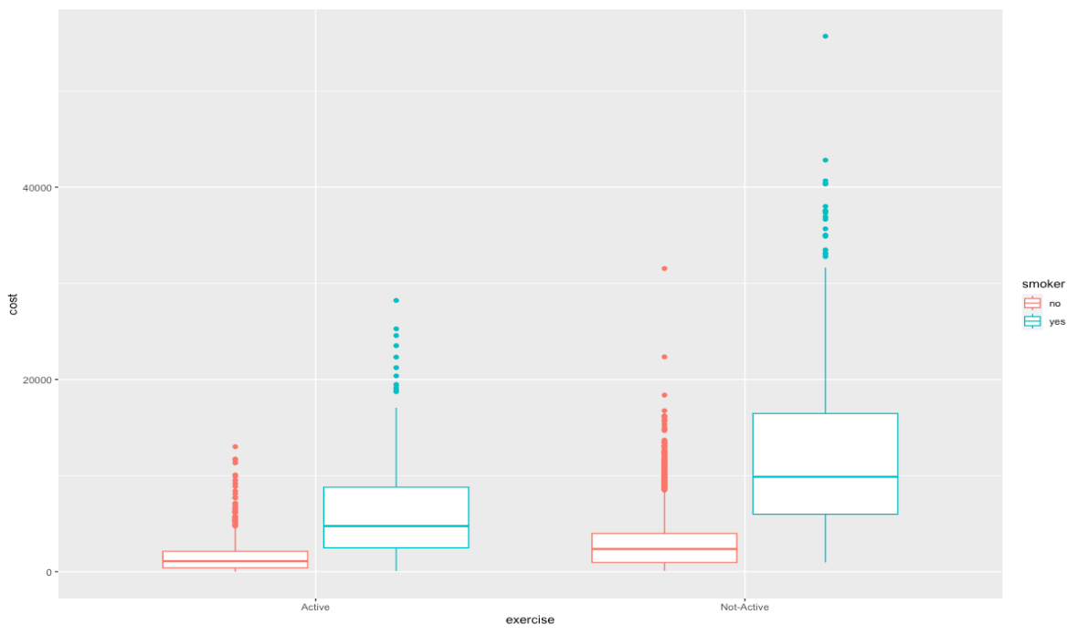
CORRELATION OF
COST AND EXERCISE
A person who exercise actively and doesn't smoke have a very low healthcare cost compared to that of a non-active person.

Slide 12
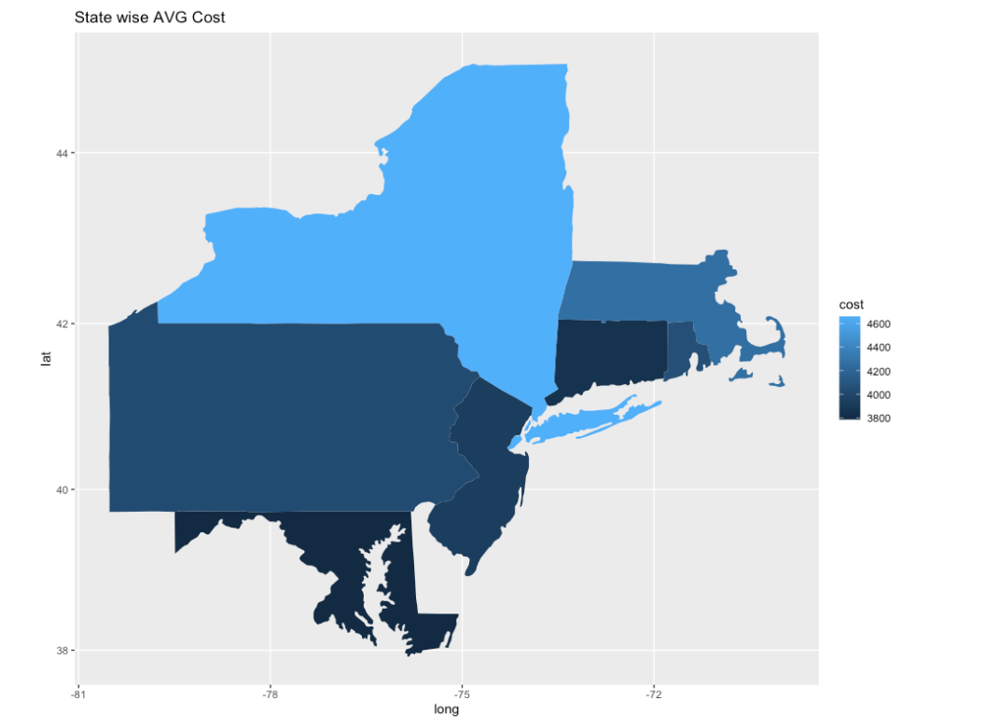
AVERAGE COST PER STATE
New Yorker's mean healthcare expenses is costlier compared to the other states

Slide 13
RECOMMENDATIONS
HMOs should hold monthly workshops and educate people about keeping active and not smoking, as well as the direct relationship of those to their healthcare expenses.
Design a healthcare program which encourages obese people to lose weight
Give proper guidance to people with "hypertension=0.5" and monitor their progress

Slide 14
THANK YOU
BHANU KIRANN
SACHIN SAMANT
SNEHAL YADAV
VISHAL REDDY

